Slide 1
RCS 122 OBJECT ORIENTED PROGRAMMING I
Lecture 17: Intro to File Handling

Slide 2
File Handling
The File class from the java.io package, allows us to work with files.
To use the File class, create an object of the class, and specify the filename or directory name. For example:
import java.io.File; // Import the File class
File myObj = new File("filename.txt"); // Specify the filename

Slide 3
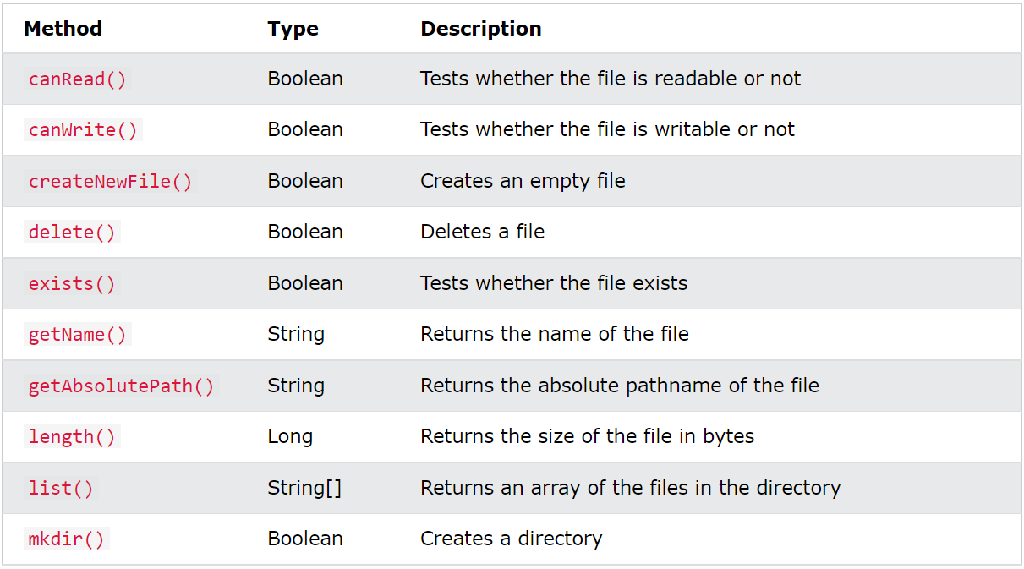
File Handling
The File class has many useful methods for creating and getting information about files. eg:

Slide 4
Create a File
To create a file in Java, you can use the createNewFile() method. This method returns a boolean value: true if the file was successfully created, and false if the file already exists. Note that the method is enclosed in a try...catch block. This is necessary because it throws an IOException if an error occurs (if the file cannot be created for some reason):

Slide 5
Create a File
Example:
import java.io.File; // Import the File class
import java.io.IOException; // Import the IOException class to handle errors
public class CreateFile {
public static void main(String[] args) {
try {
File myObj = new File("filename.txt");
if (myObj.createNewFile()) {
System.out.println("File created: " + myObj.getName());
} else {
System.out.println("File already exists.");
}
} catch (IOException e) {
System.out.println("An error occurred.");
e.printStackTrace();
}
}
}
NOTE: As we haven't learnt about Exception Handling, just concentrate on File Handling (i.e. learn how to create files, write data to files, and read from files).

Slide 6
Create a File
To create a file in a specific directory (requires permission), specify the path of the file and use double backslashes to escape the "\" character (for Windows). On Mac and Linux you can just write the path, like: /Users/name/filename.txt.
For example,
File myObj = new File("C:\\Users\\MyName\\filename.txt");

Slide 7
Write To a File
In the following example, we use the FileWriter class together with its write() method to write some text to the file we’ve created. Note that when you are done writing to the file, you should close it with the close() method:

Slide 8
Write To a File
import java.io.FileWriter; // Import the FileWriter class
import java.io.IOException; // Import the IOException class to handle errors
public class WriteToFile {
public static void main(String[] args) {
try {
FileWriter myWriter = new FileWriter("filename.txt");
myWriter.write("Files in Java might be tricky, but it is fun enough!");
myWriter.close();
System.out.println("Successfully wrote to the file.");
} catch (IOException e) {
System.out.println("An error occurred.");
e.printStackTrace();
}
}
}

Slide 9
You can read more about files at
w3schools.com

Slide 10
END

